Slide 1
caArray User Community Meeting
Release 2.1.0 and further
Call in: 877-416-5524
Participant Passcode: 2627056
Centra: http://ncicb.centra.com
Meeting ID: array_august6
August 6, 2008

Slide 2
Agenda
Latest release: 2.1.0
Upcoming minor release: 2.1.1
Sneak preview into next major release: 2.2.0
Request for feedback

Slide 3
Latest Release:
2.1.0
Latest release 2.1.0
  Will be on https://array.nci.nih.gov within a week.
  2.1.0 installer and upgrade installer will be available soon after.
Data
  Rembrandt gene expression data is now hosted on caArray
    Experiment name: Rembrandt_GeneExpression
  More TCGA data now available
Programmatic API
  API client examples will be available in Gforge within a week under:
    caArray 2.0 -> Docs -> User Community -> API Client Samples
User's Guide for 2.1.0
  Now contains detailed documentation about creating MAGE-TAB files for bulk import into caArray. (Includes information about caArray-specific validation and Best Practices.)

Slide 4
Latest Release:
Main 2.1.0 features
Improved efficiency of programmatic Grid API
  Grid Transfer makes for fast download of file contents.
  Grid retrieval of parsed array data is more efficient now.
Flexible association of data files to biomaterials
  System can auto-generate individual biomaterial chains; OR
  System can auto-generate a single biomaterial chain; OR
  User can associate data files to a specific biomaterial/hybridization.
New Sample-centric view
  A well-known URL to navigate directly to a Sample details page.
  Unique Sample External ID that is defined by the user.
More than 40 items addressed from the Gforge trackers.

Slide 5
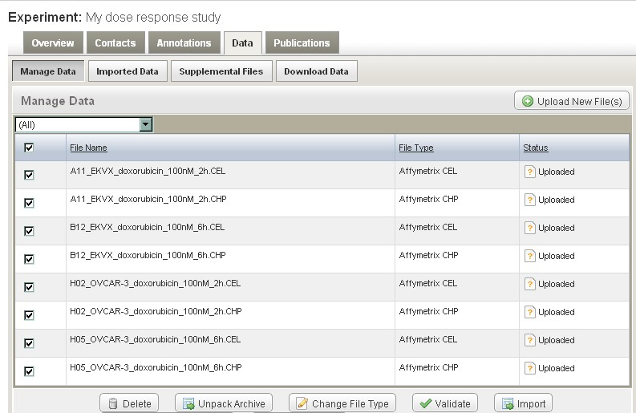
Latest Release:
Associating Data Files to Biomaterials
  Option 1: System auto-generates biomaterial chains based on file name.

Slide 6
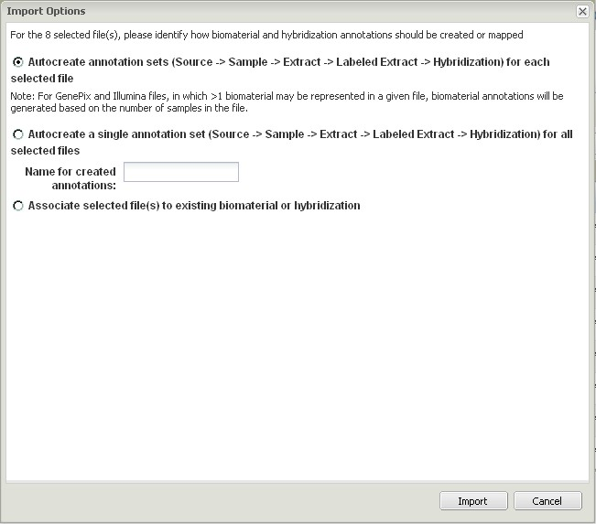
Latest Release:
Associating Data Files to Biomaterials

Slide 7
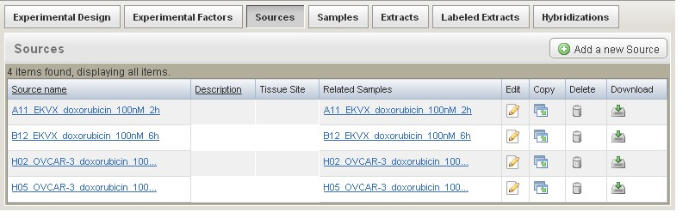
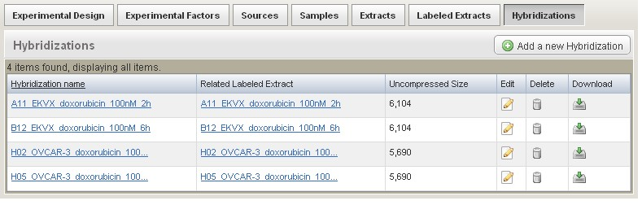
Latest Release:
Associating Data Files to Biomaterials

Slide 8
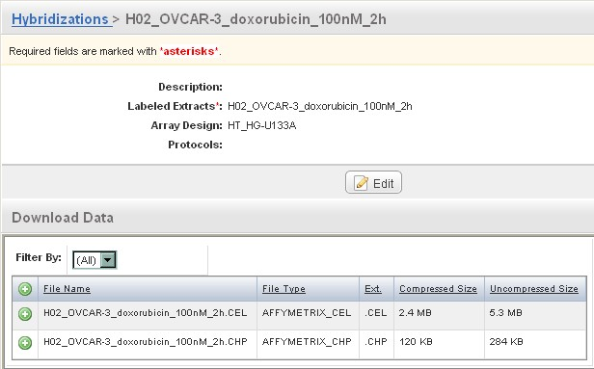
Latest Release:
Associating Data Files to Biomaterials

Slide 9
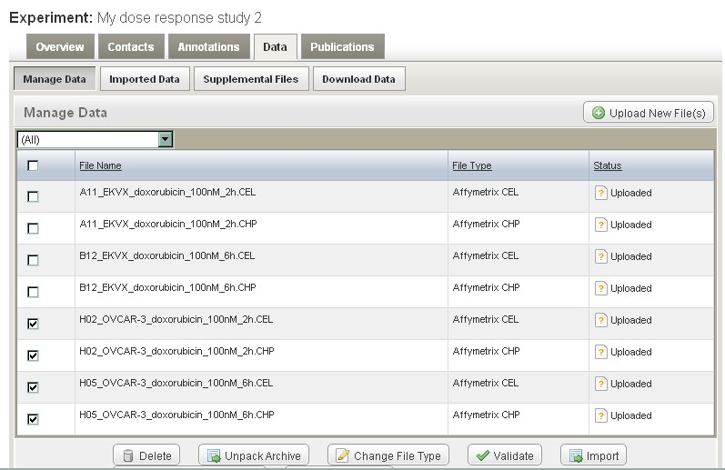
Latest Release:
Associating Data Files to Biomaterials
  Option 2: System auto-generates a single biomaterial chain.

Slide 10
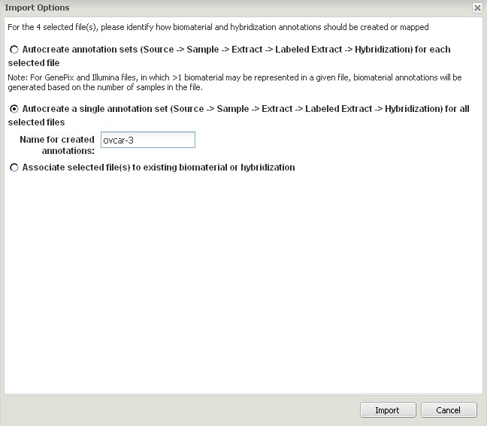
Latest Release:
Associating Data Files to Biomaterials

Slide 11
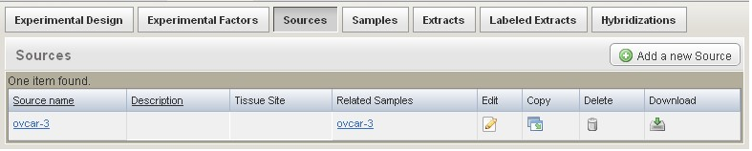
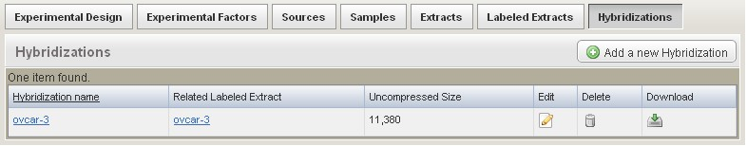
Latest Release:
Associating Data Files to Biomaterials

Slide 12
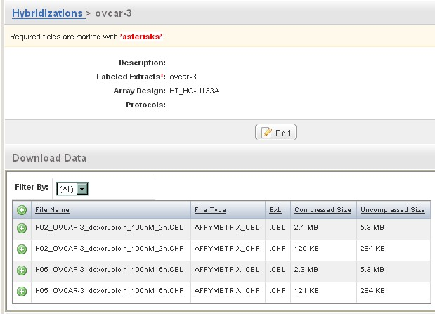
Latest Release:
Associating Data Files to Biomaterials

Slide 13
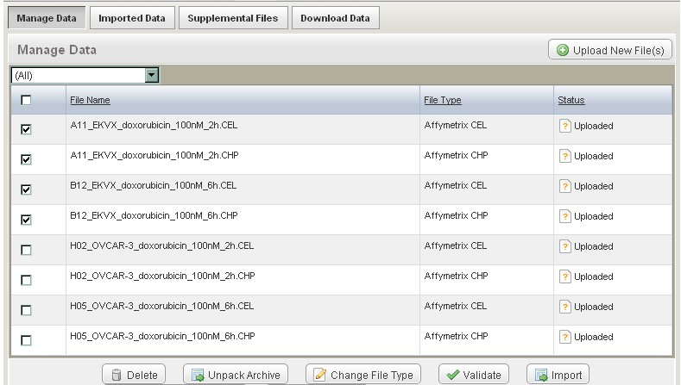
Latest Release:
Associating Data Files to Biomaterials
  Option 3: User associates data files to existing biomaterial.

Slide 14
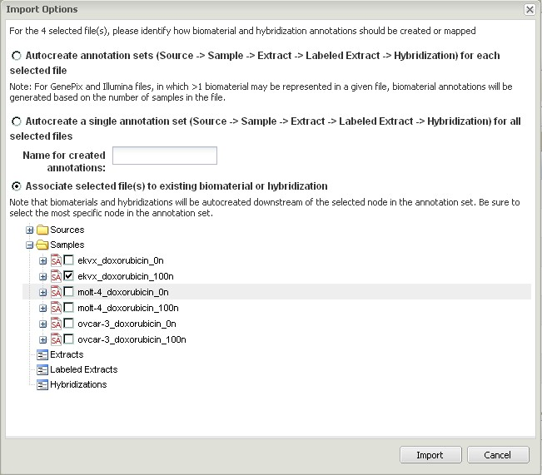
Latest Release:
Associating Data Files to Biomaterials

Slide 15
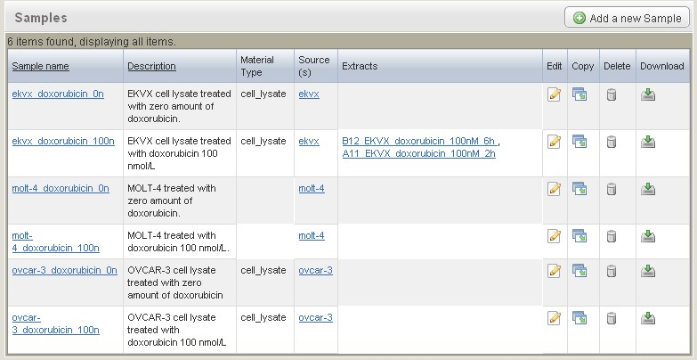
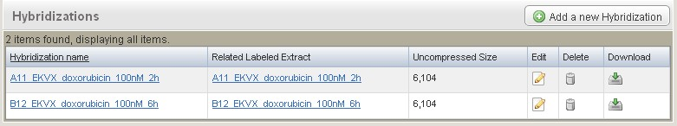
Latest Release:
Associating Data Files to Biomaterials

Slide 16
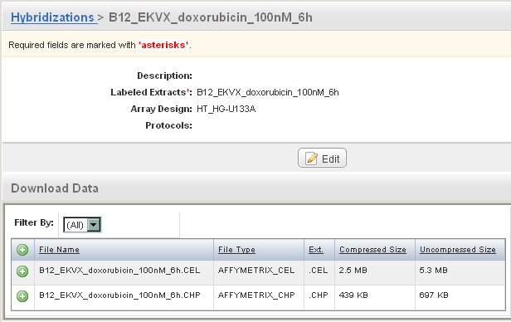
Latest Release:
Associating Data Files to Biomaterials

Slide 17
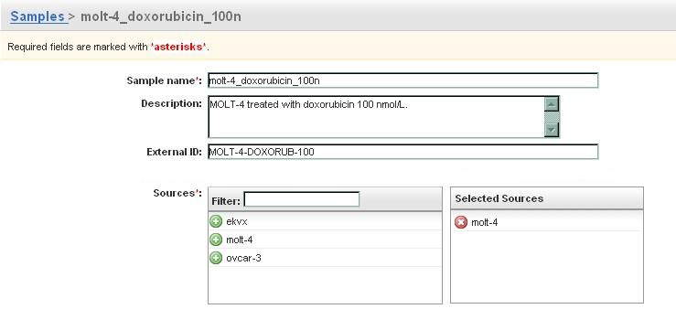
Latest Release:
Sample-centric View
Enter the External Sample Id
  Manually through the Annotations UI; or
  In bulk through a MAGE-TAB SDRF file. (Sample Name column is followed by a Characteristics [ExternalSampleId] column.)

Slide 18
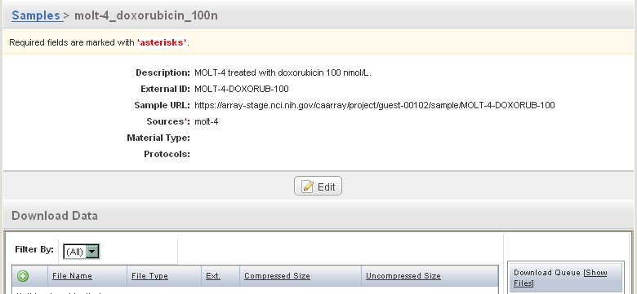
Latest Release:
Sample-centric View
System makes Sample URL available
  Directly navigate to Sample details page.
  Based on the External Sample Id attribute.

Slide 19
Upcoming Minor Release:
2.1.1
Schedule
  Anticipated release in September.
Main focus of 2.1.1
  Affymetrix Exon arrays: Parse .PGF and .CLF files for array design import to support Affymetrix Exon arrays and any other array designs that use these formats.
Detailed Scope:
  Implementation Items Tracker: New Gforge tracker replaces Defect tracker and Feature Request tracker.
  Filter tracker items by target_release=2.1.1 for detailed visibility into current scope:
  https://gforge.nci.nih.gov/tracker/?atid=1344&group_id=305&func=browse

Slide 20
Sneak Preview:
Main 2.2.0 features anticipated
Sample-based search
  Search criteria = biomaterial annotations
  Results = Samples or Experiments
Secure access through the Grid API
Redesign of programmatic API
  Paving the way for backwards compatibility
  Transitioning all users to the Grid API
  Rich set of caGRID analytical services to provide a quick and convenient way to get to data of interest (avoiding tedious traversal of domain object graph).
Illumina support
  Parsing of Group Probe Profile files.
  Parsing of .bgx array design format.

Slide 21
Avenues for Feedback
caArray Users listserv
  We welcome and encourage active exchanges on this listserv to share experiences with the product
Community Change Request tracker
  http://gforge.nci.nih.gov/tracker/?atid=1339&group_id=305&func=browse
This meeting
Molecular Analysis Knowledge Center
  Resources will come online soon.
Next Meeting:
Wednesday, September 3, 2:00 PM ET

